Slide 1



Анализ ценовой политики
View in Power BI
Last data refresh:
25.10.2023 6:30:20 UTC
Downloaded at:
26.10.2023 8:54:40 UTC

Slide 2
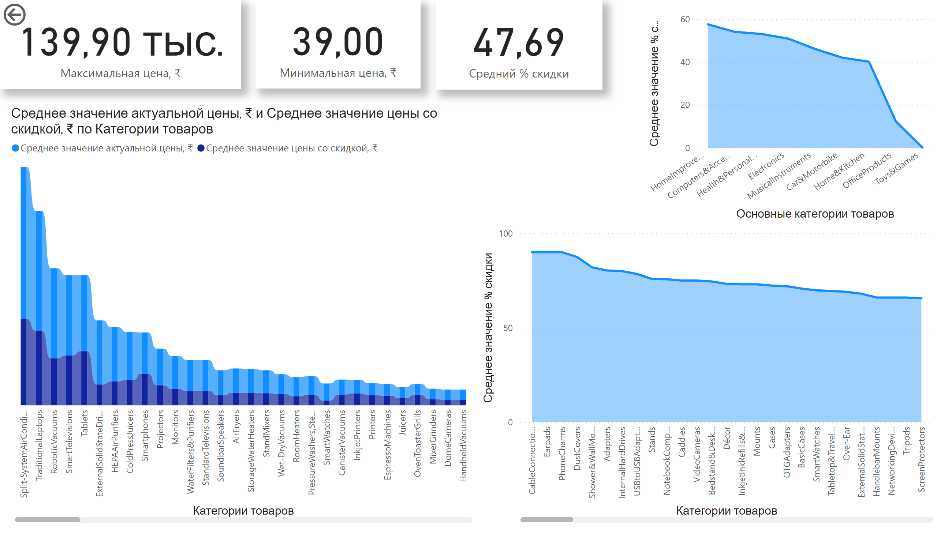
Страница 1
Notes:
ribbonChart
No alt text provided
areaChart
No alt text provided
card
No alt text provided
card
No alt text provided
actionButton
No alt text provided
card
No alt text provided
areaChart
No alt text provided

